Slide 1

Counting

Slide 2
Why?
To solve different types of problem
Counting is used to determine the complexity of algorithms.
Recently, it has played a key role in mathematical biology, especially in sequencing DNA.
Furthermore, counting techniques are used extensively when probabilities of events are computed.

Slide 3
Basic Counting Principles: THE SUM RULE
The Sum Rule
If a task can be done either in one of n₁ ways or in one of n₂ ways, where none of the set of n₁ ways is the same as any of the set of n₂ ways, then there are n₁ ₊ n₂ ways to do the task.
Sum Rule: If no two events can occur at the same time, then one of the events can occur in: n1+n2+n3+···ways.
Sum Rule Principle: Suppose A and B are disjoint sets. Then n(A∪B) = n(A) + n(B)

Slide 4
Basic Counting Principles: THE SUM RULE
The Sum Rule
If a task can be done either in one of n₁ ways or in one of n₂ ways, where none of the set of n₁ ways is the same as any of the set of n₂ ways, then there are n₁ ₊ n₂ ways to do the task.
Sum Rule: If no two events can occur at the same time, then one of the events can occur in: n1+n2+n3+···ways.
Sum Rule Principle: Suppose A and B are disjoint sets. Then n(A∪B) = n(A) + n(B)

Slide 5
Basic Counting Principles: THE SUM RULE
The Sum Rule
If a task can be done either in one of n₁ ways or in one of n₂ ways, where none of the set of n₁ ways is the same as any of the set of n₂ ways, then there are n₁ ₊ n₂ ways to do the task.
Sum Rule: If no two events can occur at the same time, then one of the events can occur in: n1+n2+n3+···ways.
Sum Rule Principle: Suppose A and B are disjoint sets. Then n(A∪B) = n(A) + n(B)

Slide 6
The Sum Rule : Example
Problem : A student can choose a computer project from one of three lists. The three lists contain 23, 15, and 19 possible projects, respectively. No project is on more than one list. How many possible projects are there to choose from?
Solution: The student can choose a project by selecting a project from the first list, the second list, or the third list. Because no project is on more than one list, by the sum rule there are 23+15+19=57 ways to choose a project.

Slide 7
Basic Counting Principles: THE PRODUCT RULE
The Product Rule
Suppose that a procedure can be broken down into a sequence of two tasks. If there are n₁ ways to do the first task and for each of these ways of doing the first task, there are n₂ ways to do the second task, then there are n₁.n₂ ways to do the procedure.
Product Rule: If the events occur one after the other, then all the events can occur in the order indicated in: n1·n2·n3·...ways.
Product Rule Principle: Let A × B be the Cartesian product of sets A and B. Then
n(A×B) = n(A) · n(B)

Slide 8
Basic Counting Principles: THE PRODUCT RULE
The Product Rule
Suppose that a procedure can be broken down into a sequence of two tasks. If there are n₁ ways to do the first task and for each of these ways of doing the first task, there are n₂ ways to do the second task, then there are n₁.n₂ ways to do the procedure.
Product Rule: If the events occur one after the other, then all the events can occur in the order indicated in: n1·n2·n3·...ways.
Product Rule Principle: Let A × B be the Cartesian product of sets A and B. Then
n(A×B) = n(A) · n(B)

Slide 9
Basic Counting Principles: THE PRODUCT RULE
The Product Rule
Suppose that a procedure can be broken down into a sequence of two tasks. If there are n₁ ways to do the first task and for each of these ways of doing the first task, there are n₂ ways to do the second task, then there are n₁.n₂ ways to do the procedure.
Product Rule: If the events occur one after the other, then all the events can occur in the order indicated in: n1·n2·n3·...ways.
Product Rule Principle: Let A × B be the Cartesian product of sets A and B. Then
n(A×B) = n(A) · n(B)

Slide 10
The Product Rule : Example
Problem : How many different license plates can be made if each plate contains a sequence of three uppercase English letters followed by three digits.
Solution: There are 26 choices for each of the three uppercase English letters and ten choices for each of the three digits. Hence, by the product rule there are a total of 26·26·26·10·10·10 = 17,576,000 possible license plates.

Slide 11
The Product Rule : Example
Problem : Suppose a college has 3 different history courses, 4 different literature courses, and 2 different sociology courses. What is the number of ways a student can choose just one of each kind of courses?
Solution:

Slide 12
The Product Rule : Example
Problem : There are 32 microcomputers in a computer center. Each microcomputer has 24 ports. How many different ports to a microcomputer in the center are there?
Solution: The procedure of choosing a port consists of two tasks, first picking a microcomputer and then picking a port on this microcomputer. Because there are 32 ways to choose the microcomputer and 24 ways to choose the port no matter which microcomputer has been selected, the product rule shows that there are 32·24=768 ports.:

Slide 13
The Product Rule : Example
Problem : How many different bit strings of length seven are there?
Solution: Each of the seven bits can be chosen in two ways, because each bit is either 0 or 1. Therefore, the product rule shows there are a total of 2^7=128 different bit strings of length seven.

Slide 14

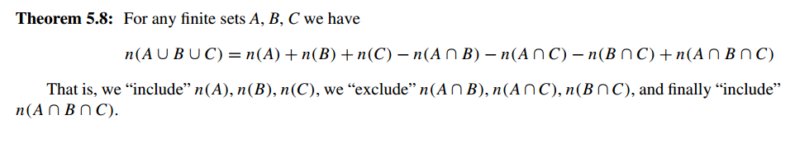
The Subtraction Rule (Inclusion–Exclusion for Two Sets)
Theorem
If a task can be done in either n1 ways or n2 ways, then the number of ways to do the task is n1+ n2 minus the number of ways to do the task that are common to the two different ways.

Slide 15
The Subtraction Rule : Example
Problem : A computer company receives 350 applications from computer graduates for a job planning a line of new Web servers. Suppose that 220 of these applicants majored in computer science, 147 majored in business, and 51 majored both in computer science and in business. How many of these applicants majored neither in computer science nor in business?
Solution: Let A1 be the set of students who majored in computer science and A2 the set of students who majored in business. Then A1∪A2 is the set of students who majored in computer science or business (or both), and A1∩A2 is the set of students who majored both in computer science and in business. By the subtraction rule the number of students who majored either in computer science or in business (or both) equals
|A1∪A2|=|A1|+|A2|−|A1∩A2| = 220 + 147 − 51 = 316.
We conclude that 350 − 316 = 34 of the applicants majored neither in computer science nor in
business.

Slide 16
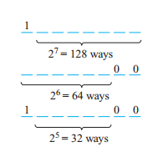
The Subtraction Rule : Example
Problem : How many bit strings of length eight either start with a 1 bit or end with the two bits 00?
Solution:

Slide 17
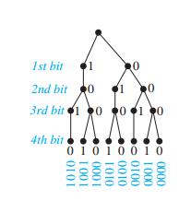
Tree Diagram
How many bit strings of length four do not have two consecutive 1s?

Slide 18
Problem
A history class contains 8 male students and 6 female students. Find the number of ways that the class can elect:
1 class representative;
2 class representatives, 1 male and 1 female;
1 president and 1 vice president.

Slide 19
Problem
32 People who save paper or bottles (or both) for recycling, 30 save paper and 14 save bottles. Find the number of people who
Save both;
Save only paper;
Save only bottles.

Slide 20
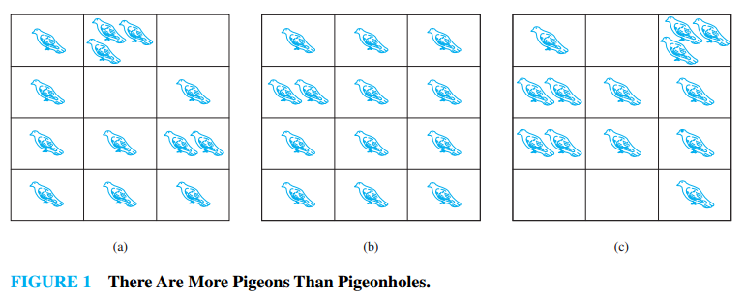
The Pigeonhole Principle

Slide 21
The Pigeonhole Principle
Theorem
If k is a positive integer and k+1 or more objects are placed into k boxes, then there is at least one box containing two or more of the objects.

Slide 22
The Pigeonhole Principle
Theorem
If k is a positive integer and k+1 or more objects are placed into k boxes, then there is at least one box containing two or more of the objects.

Slide 23
The Pigeonhole Principle
Example
Suppose a department contains 13 professors, then two of the professors (pigeons) were born in the same month (pigeonholes)
Among any group of 367 people, there must be at least two with the same birthday, because there are only 366 possible birthdays.

Slide 24
The Pigeonhole Principle
Example
Suppose a department contains 13 professors, then two of the professors (pigeons) were born in the same month (pigeonholes)
Among any group of 366 people, there must be at least two with the same birthday, because there are only 365 possible birthdays.

Slide 25
The Pigeonhole Principle
Example
Among any group of 367 people, there must be at least two with the same birthday, because there are only 366 possible birthdays.
How many students must be in a class to guarantee that at least two students receive the same score on the final exam, if the exam is graded on a scale from 0 to 100 points?
Solution: There are 101 possible scores on the final. The pigeonhole principle shows that among any 102 students there must be at least 2 students with the same score.

Slide 26
The Generalized Pigeonhole Principle
Theorem
If N objects are placed into k boxes, then there is at least one box containing at least [N/k] objects.
If k pigeonholes are occupied by [nk+1] or more pigeons, where k is a positive integer, then at least one pigeonhole is occupied by [n+1] or more pigeons

Slide 27
The Generalized Pigeonhole Principle
Example
Among 100 people there are at least 100/12=9 who were born in the same month.
What is the minimum number of students required in a discrete mathematics class to be sure that at least six will receive the same grade, if there are five possible grades, A, B, C, D, and F?
Solution: The minimum number of students needed to ensure that at least six students receive the same grade is the smallest integer N such thatN/5=6. The smallest such integer is N=5·5+1=26. If you have only 25 students, it is possible for there to be five who have received each grade so that no six students have received the same grade. Thus, 26 is the minimum number of students needed to ensure that at least six students will receive the same grade.

Slide 28
The Generalized Pigeonhole Principle
Example
What is the minimum number of students required in a discrete mathematics class to be sure that at least six will receive the same grade, if there are five possible grades, A, B, C, D, and F?
Solution: The minimum number of students needed to ensure that at least six students receive the same grade is the smallest integer N such that N/5=6. The smallest such integer is N=5·5+1=26. If you have only 25 students, it is possible for there to be five who have received each grade so that no six students have received the same grade. Thus, 26 is the minimum number of students needed to ensure that at least six students will receive the same grade.

Slide 29
Problem!!!
In how many ways can we arrange five students in a line for a picture?
In how many ways can we select three students from a group of five students to stand in line for a picture?

Slide 30
Permutations
Theorem
Any arrangement of a set of n objects in a given order is called a permutation of the object (taken all at a time).

Slide 31
Permutations
Theorem
Any arrangement of a set of n objects in a given order is called a permutation of the object (taken all at a time).
In how many ways can we arrange three letter A, B, C without repetition?

Slide 32
Permutations
Theorem
Any arrangement of a set of n objects in a given order is called a permutation of the object (taken all at a time).
In how many ways can we arrange three letter A, B, C without repetition?
Corollary
There are n! permutations of n objects (taken all at a time).

Slide 33
r-permutation
Theorem
Any arrangement of any r ≤ n of n objects in a given order is called an “r-permutation” or “a permutation of then objects taken r at a time.”

Slide 34
r-permutation
Theorem
Any arrangement of any r ≤ n of n objects in a given order is called an “r-permutation” or “a permutation of then objects taken r at a time.”
The number of permutations of n objects taken r at a time will be denoted by

Slide 35
r-permutation
In how many ways can we select three students from a group of five students to stand in line for a picture?
In how many ways can we select four students from a group of five students to stand in line for a picture

Slide 36
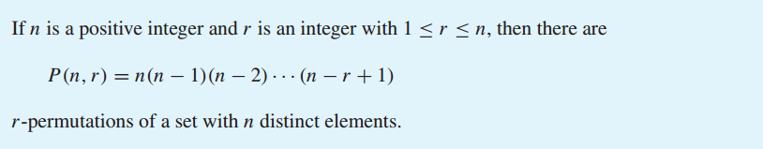
r-permutation
Theorem

Slide 37
P (n, r) = n(n−1)(n−2)···(n−r+1)
Proof
We will use the product rule to prove that this formula is correct. The first element of the permutation can be chosen in n ways because there are n elements in the set. There are n−1 ways to choose the second element of the permutation, because there aren−1 elements left in the set after using the element picked for the first position. Similarly, there are n−2 ways to choose the third element, and so on, until there are exactly n−(r−1)=n−r+1 ways to choose the r^{th} element. Consequently, by the product rule, there are n(n−1)(n−2)···(n−r+1) r-permutations of the set.

Slide 38
r-permutation
Theorem
Note that P(n,0)=1 whenever n is a nonnegative integer
because there is exactly one way to order zero elements.
That is, there is exactly one list with no elements in it, namely the empty list.

Slide 39
r-permutation
COROLLARY

Slide 40
r-permutation : Example
Problem: How many ways are there to select a first-prize winner, a second-prize winner, and a third-prize winner from 100 different people who have entered a contest?
Solve: Because it matters which person wins which prize, the number of ways to pick the three prize winners is the number of ordered selections of three elements from a set of 100 elements, that is, the number of 3-permutations of a set of 100 elements. Consequently, the answer is
P(100,3) = 100·99·98 = 970,200.

Slide 41
r-permutation : Example
Problem: Suppose that there are eight runners in a race. The winner receives a gold medal, the second place finisher receives a silver medal, and the third-place finisher receives a bronze medal. How many different ways are there to award these medals, if all possible outcomes of the race can occur and there are no ties?
Solve: The number of different ways to award the medals is the number of 3-permutations of a set with eight elements. Hence, there are
P(8,3) = 8·7·6 = 336 possible ways to award the medals.

Slide 42
r-permutation : Example
Problem: How many permutations of the letters ABCDEFGH contain the string ABC?
Solve: Because the letters ABC must occur as a block, we can find the answer by finding the number of permutations of six objects, namely, the block ABC and the individual letters D, E, F, G, and H. Because these six objects can occur in any order, there are 6!=720 permutations of the letters ABCDEFGH in which ABC occurs as a block.

Slide 43
Permutations with Repetitions
Frequently we want to know the number of permutations of a multi set, that is, a set of objects some of which are alike. We will let
P(n; n₁,n₂, ..., n_{r})
denote the number of permutations of n objects of which n1 are alike, n2 are alike, ..., nr are alike.
The general formula follows:

Slide 44

Permutations with Repetitions
Theorem

Slide 45
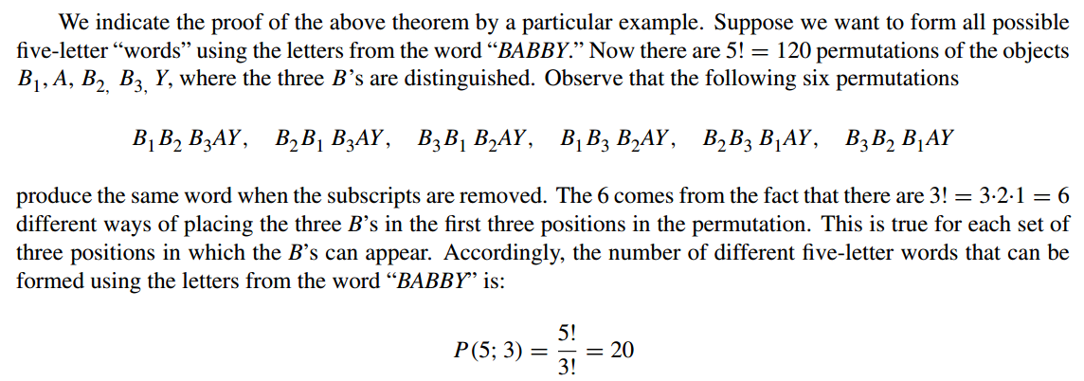
Permutations with Repetitions: Example

Slide 46
Permutations with Repetitions: Example
Find the number of seven-letter words that can be formed using the letters of the word “BENZENE.”

Slide 47
Again Problem!!!
How many different committees of three students can be formed from a group of four students?

Slide 48

r-combination
Theorem
Let S be a set with n elements. A combination of these n elements taken r at a time is any selection of r of the elements where order does not count.
Such a selection is called an r-combination; it is simply a subset of S with r elements. The number of such combinations will be denoted by

Slide 49
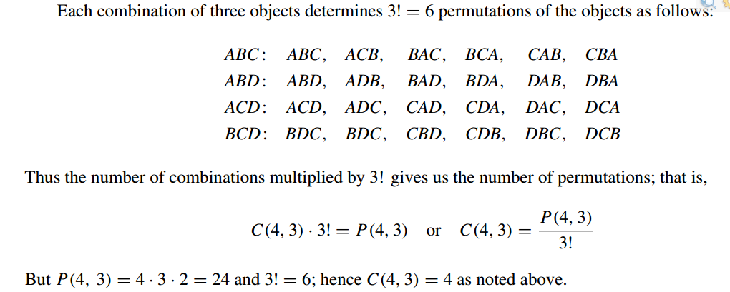
r-combination : Example
Problem: Find the number of combinations of 4 objects A,B,C,D, taken 3 at a time.
Solve:

Slide 50
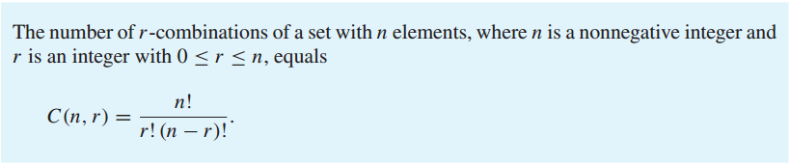

r-combination
Theorem

Slide 51
r-combination
How many ways are there to select five players from a 10-member tennis team to make a trip to a match at another school?
A group of 30 people have been trained as astronauts to go on the first mission to Mars. How many ways are there to select a crew of six people to go on this mission (assuming that all crew members have the same job)?

Slide 52
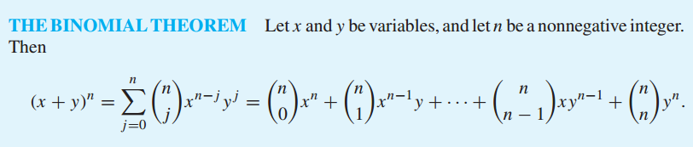
The Binomial Theorem
Theorem

Slide 53
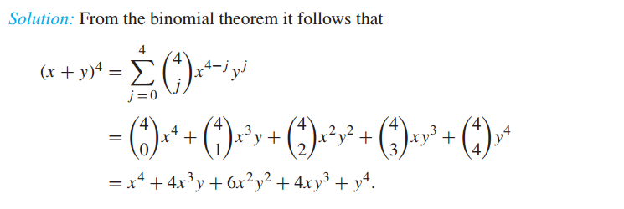
The Binomial Theorem
Problem: What is the expansion of (x+y)⁴
Solve:

Slide 54
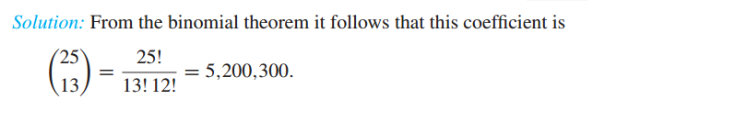
The Binomial Theorem
What is the coefficient of x¹²y¹³ in the expansion of (x+y^{)25?}
Solve:

Slide 55
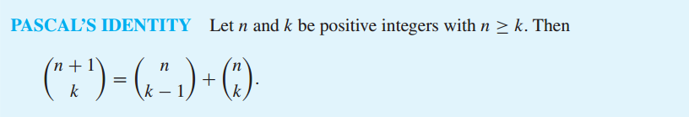
Pascal’s Identity and Triangle
Theorem

Slide 56
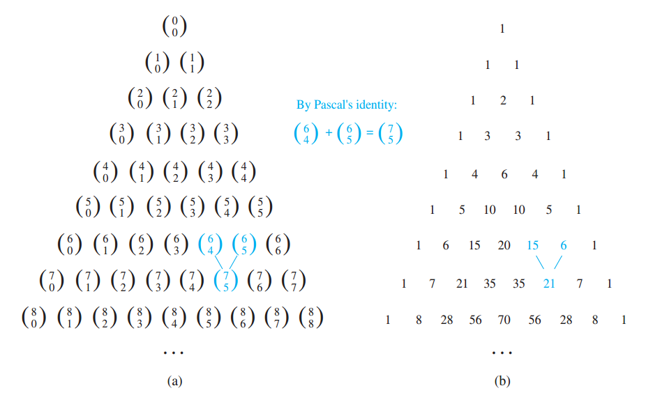
Pascal’s Identity and Triangle

